Slide 1

Azure Event Grid

Slide 2



Presenter – Jeffrey Chilberto
Independent Software Consultant
Background is in integration
Currently a software developer for a global education company
Technical writer for Microsoft Azure Architecture Center
Indie Game Developer
July 2019
May 2020

Slide 3
Event Grid
Events vs Messages
Services for eventing
Services for messaging
Illustrations of messaging services
EventGrid in more detail
Concepts
Samples

Slide 4
Events vs messages
Events
Lightweight notifications of a condition or state change
Producer does not have any expectation on the how the event is handled
Example – an event could be sent when a candidate completes a test an event could be triggered when the number of disruptions increases
Messages
Data produced by a service to be consumed or stored
Producer does have an expectation of how the event will be handled
Example – a message could be sent to register a group of users into an event
4

Slide 5
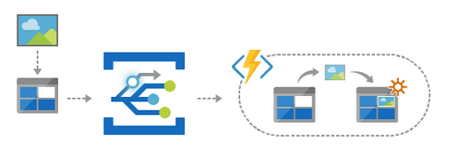
Azure services for Eventing
Event Grid
Event distribution (discrete)
Reactive programming
React to status change
Notes:
Resource uploaded – we could have an event created when a new item is added to blob storage, this would then trigger a function to perform some optimisations or validation on the image

Slide 6
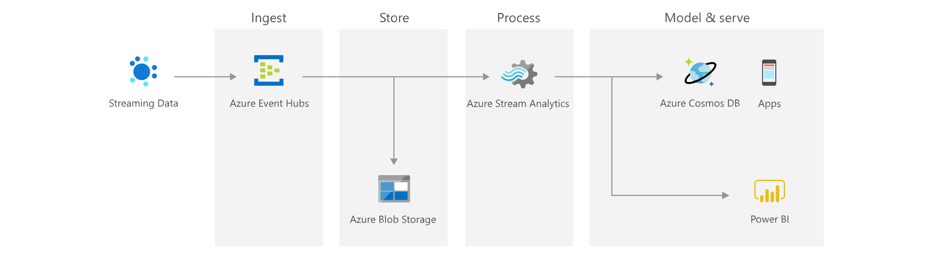
Azure services for Eventing
Event Hub
Event streaming (series)
Big data pipeline
Combine multiple sources into a single stream
Respond to change as change happens
6
Notes:
Several streams of data could be combined and evaluated and at a certain point an event is fired to save to blob storage and sent to stream analytics for further processing

Slide 7
Azure Services for messaging
Storage Queues
Reliable message store
Part of Azure Storage
Simpler messaging scenarios
Service Bus
Reliable message store
Messaging as a Service (MaaS)
Supports advanced scenarios
Feature | Storage queues | Service Bus queues
Ordering guarantee | No | Yes – FIFO
Delivery guarantee | At-Least-Once | At-Least-Once At-Most-Once
Push Notification (Long polling) | No | Yes
Batch receive | Yes | Yes
Batch send | No | Yes
Max queue size | 200 TB | 80 GB
Max message size | 64 KB | 256 KB or 1 MB
7

Slide 8
Using the services together
2
3
5
4
1
Tutorial: stream big data into a data warehouse https://docs.microsoft.com/en-us/azure/event-grid/event-grid-event-hubs-integration
8
Notes:
This diagram depicts the workflow:
1 Data sent to an Azure event hub is captured in an Azure blob storage.
2 When the data capture is complete, an event is generated and sent to an Azure event grid.
3 The event grid forwards this event data to an Azure function app.
4 The function app uses the blob URL in the event data to retrieve the blob from the storage.
5 The function app migrates the blob data to an Azure SQL data warehouse.

Slide 9
Using the services together
1
2
3
4
5
6
9
Notes:
This diagram depicts the workflow
1 An image is uploaded to blob storage
2 EventGrid subscription is activated
3 EventGrid triggers a Logic App
4 Vision service is used to analyse the image for adult content
5 A message is added to a queue for manual handling
6 an operator uses an web application to review and approve or reject content

Slide 10
Event Grid
Concepts
Event source – where the event took place
Event – what happened
Topic – endpoint where the event was published
Event subscription – route to send the event
Event handler – a service reacting to the event
10

Slide 11
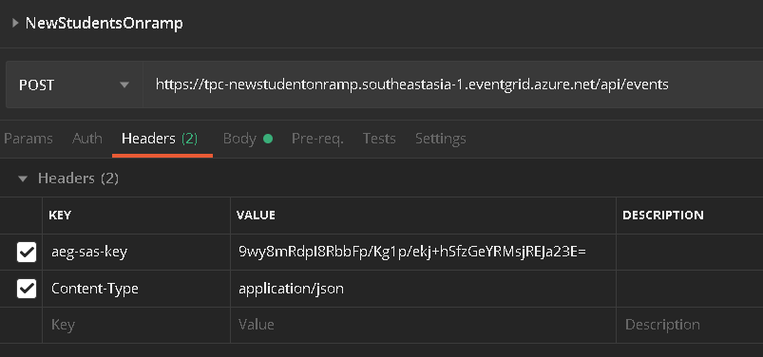
Event Grid
Guaranteed Delivery
At least once for each subscription
Security
SAS Token or key
11

Slide 12
Event Grid
Batch Delivery for high-throughput scenarios
Events per batch – Between 1 to 5000 (Default is 1)
Preferred batch size in kilobytes
Retry schedule and duration
Event Grid waits 30 seconds for a response
Uses a customisable back-off retry policy 10s, 30s, 1m, 5m, 10m, 30m, 1h for up to 24 hours
Dead-letter events
Off by default but can be enabled to write to a storage account
12

Slide 13
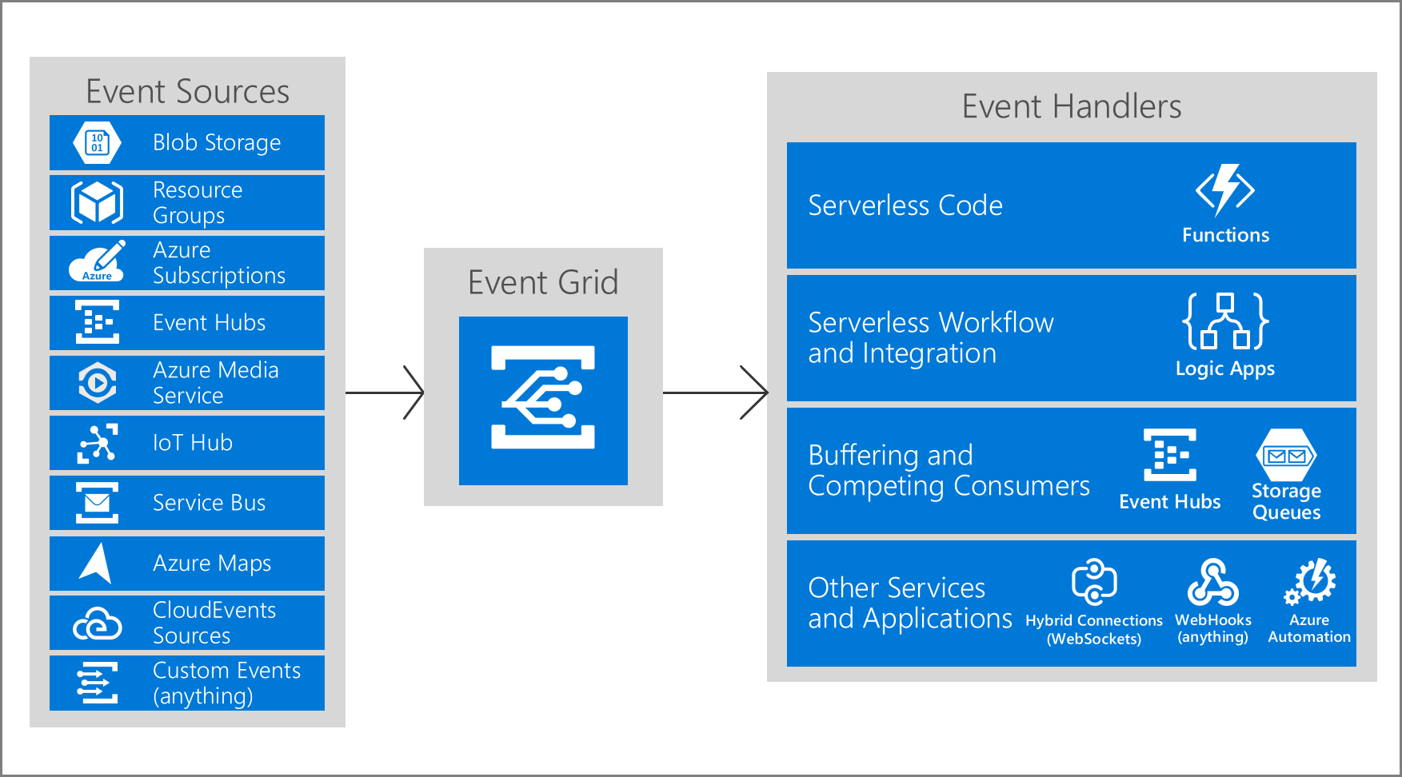
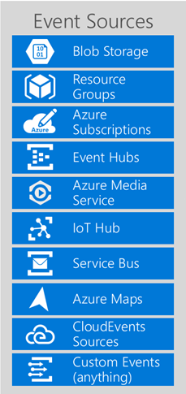
Event Grid
13

Slide 14
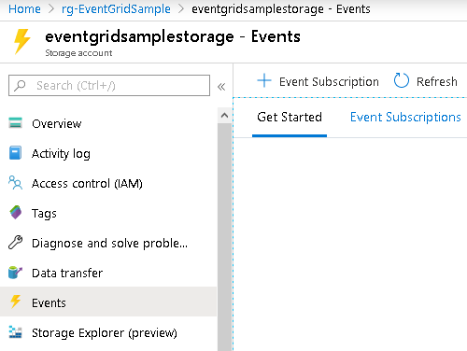
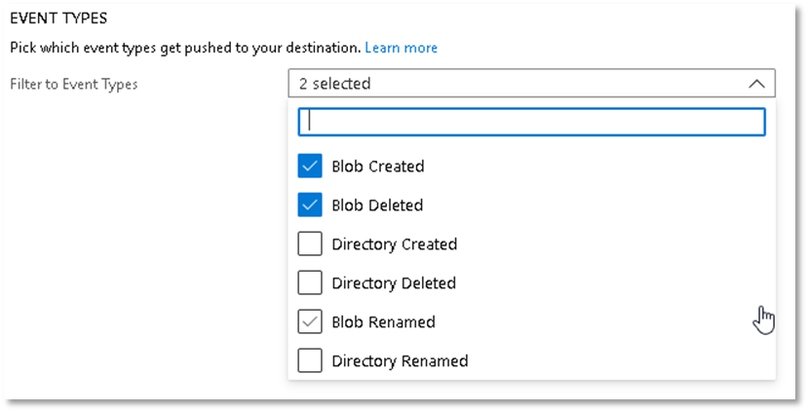
Event Grid – Event Sources
14

Slide 15
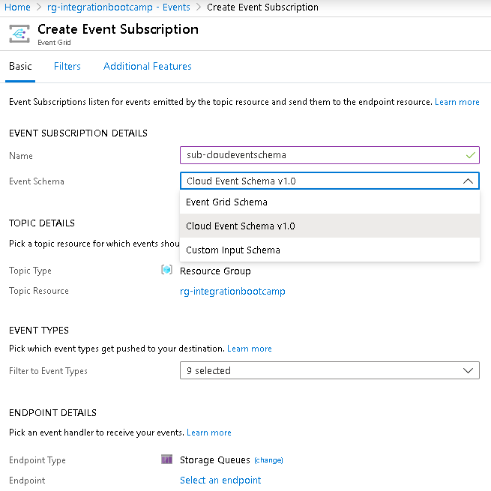
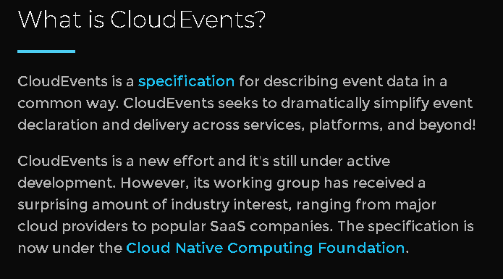
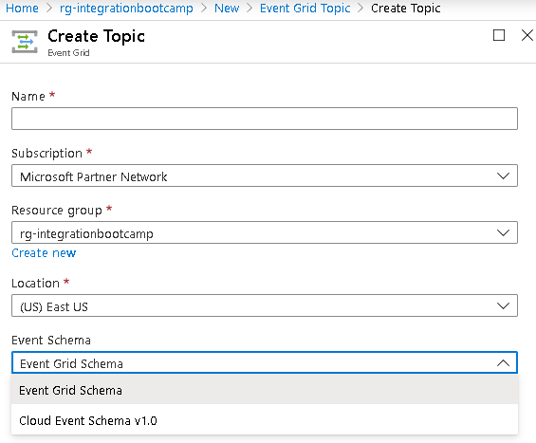
Event Grid – Event Sources
Azure Event Grid supports two schemas, default event schema and CloudEvents v1.0
Alibaba
Amazon
commercetools
Confluent
Google
Huawei
IBM
Iguazio
Intel
Lightbend
Microsoft
Oracle
PayPal
Red Hat
SAP
Serverless Inc
SolarWinds
VMWare
15

Slide 16
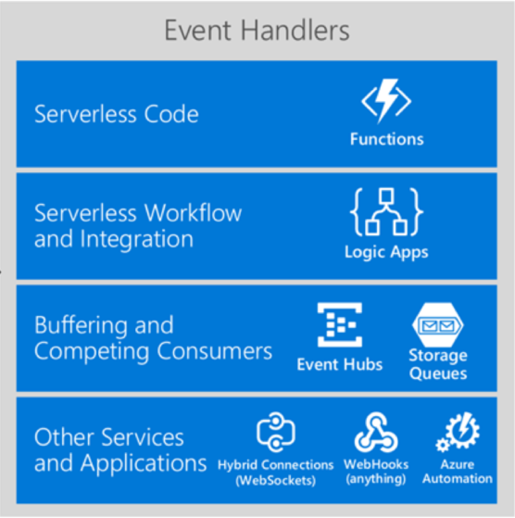
Event Grid – Event Handlers
16

Slide 17
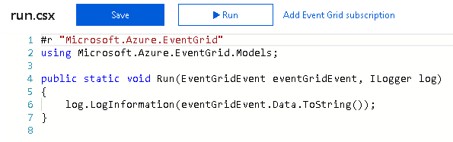
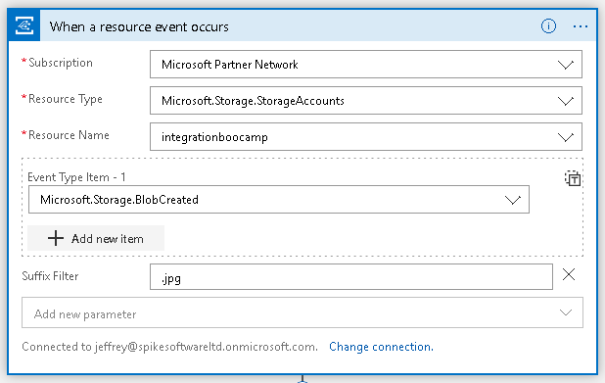
Event Grid – Event Handlers
17

Slide 18
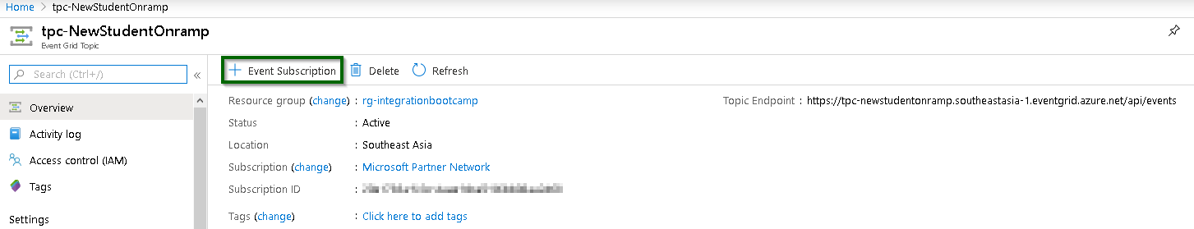
Event Grid – Subscriptions
Creating a new Event Subscription
18

Slide 19
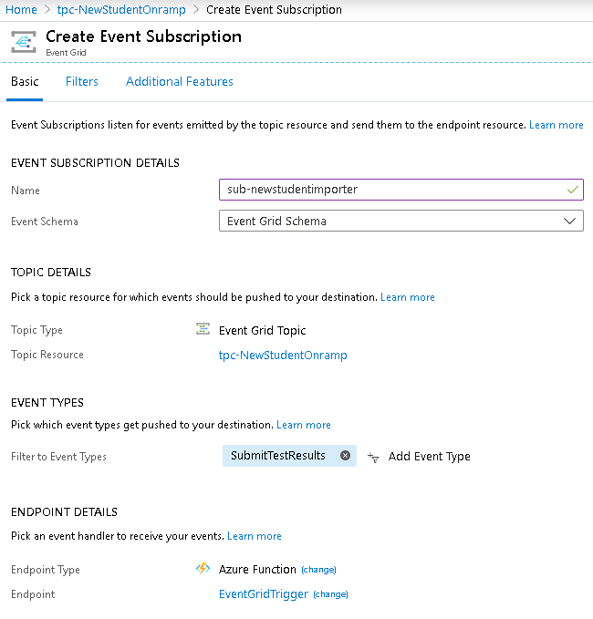
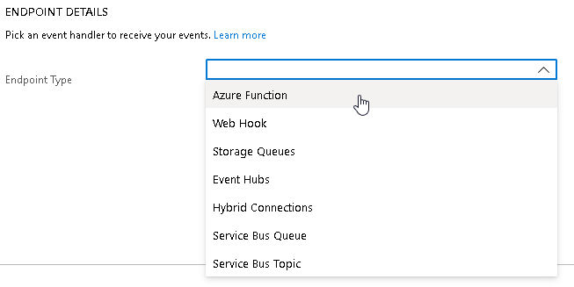
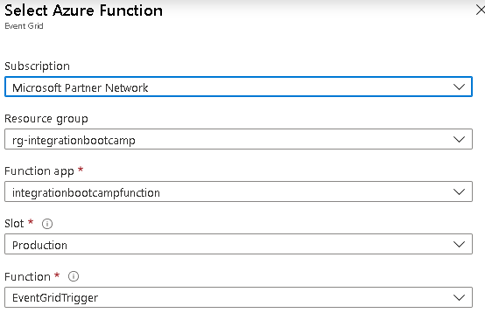
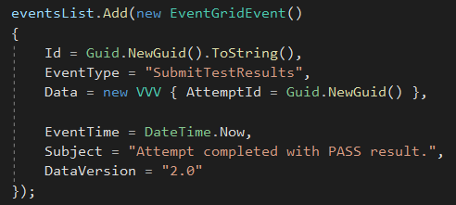
Event Grid – Subscriptions
19

Slide 20
Event Grid - Monitoring
Metrics
For Topics:
Publish Succeeded – Sent to the topic and processed with a 2xx response
Publish Failed – Sent to the topic but rejected with an error code
Unmatched – No matching event subscription
For Subscriptions:
Delivery Succeeded – Delivered successfully with a 2xx response
Delivery Failed – Delivered but received a 4xx or 5xx response
Expired Events – Not delivered with all retry attempts and the event was dropped
Matched Events – Event in the topic was matched by the subscription
20

Slide 21
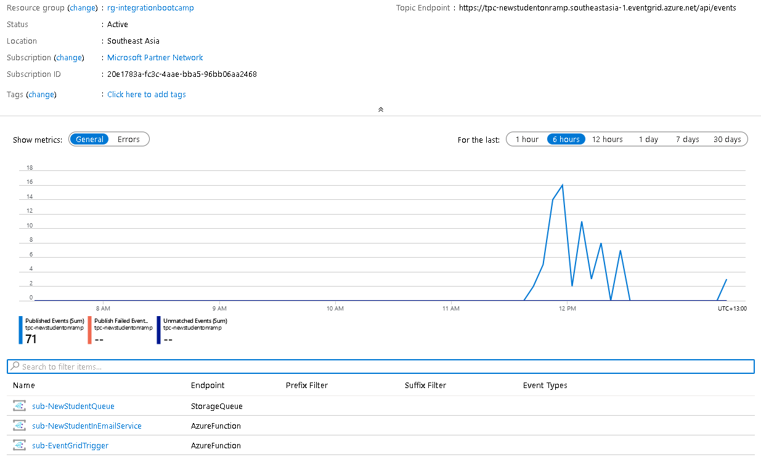
Event Grid - Monitoring
21

Slide 22
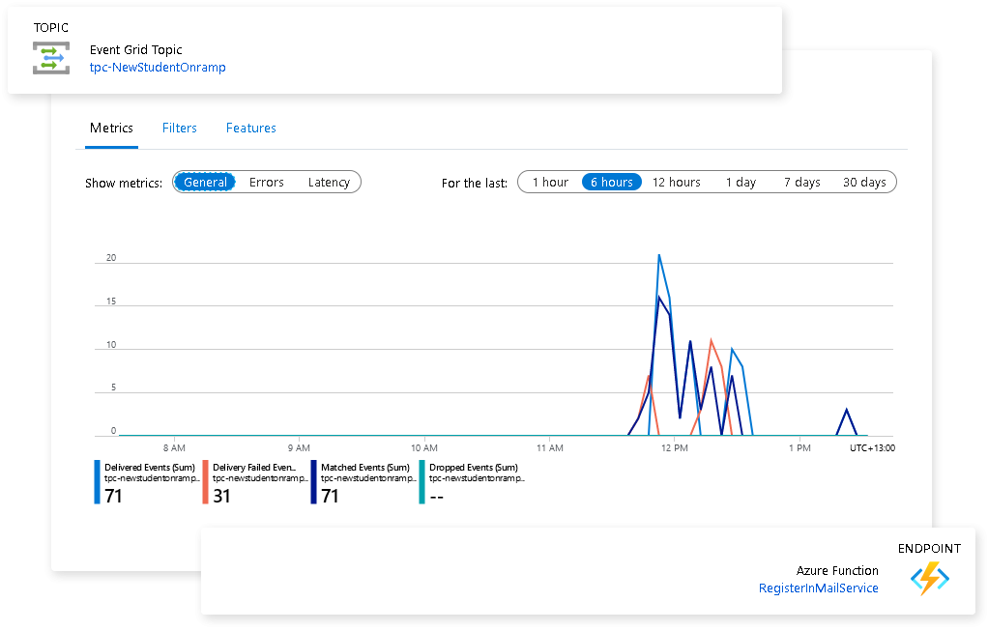
Event Grid - Monitoring
22

Slide 23
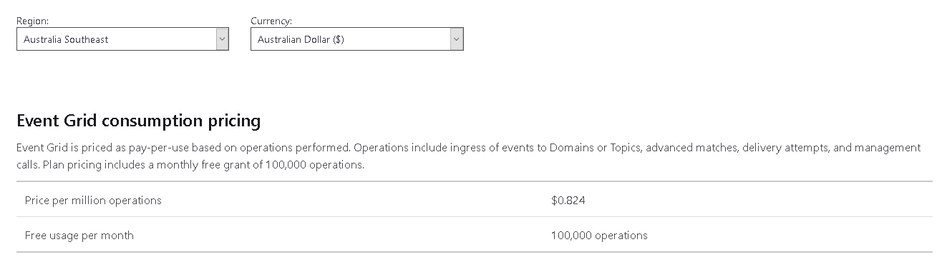
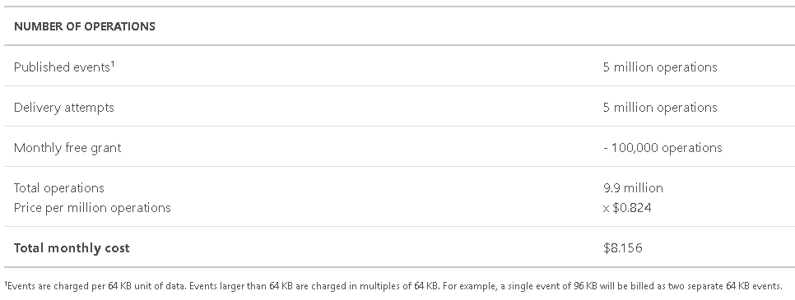
Event Grid - Pricing

Slide 24
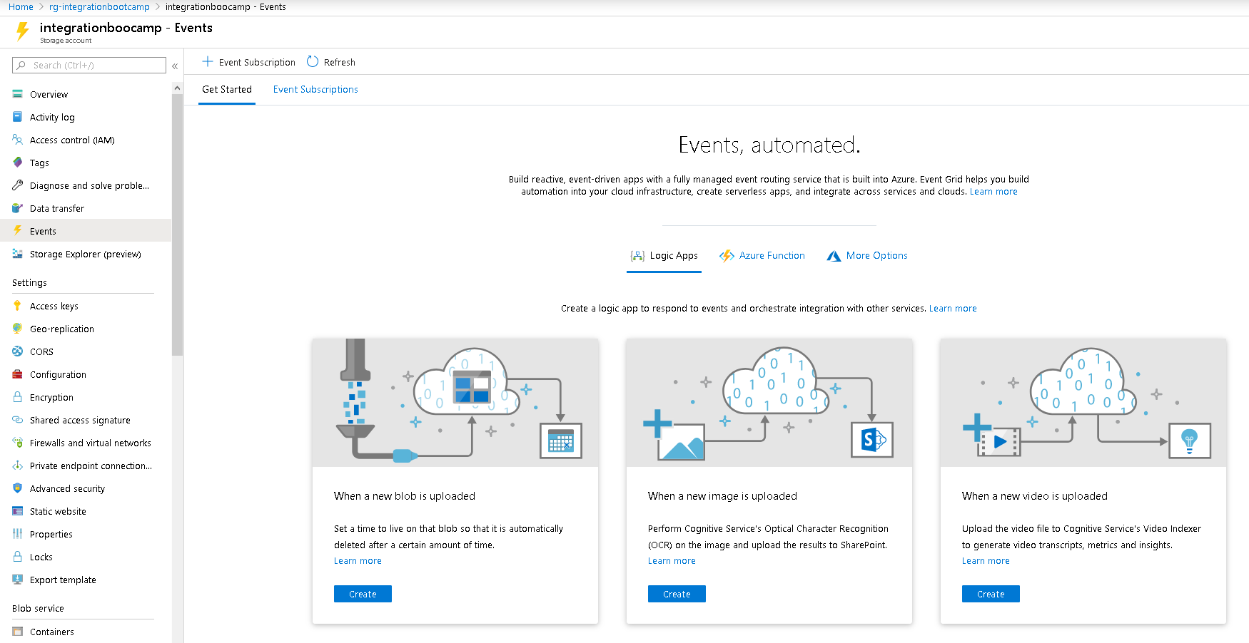
Event Grid – Getting Started
Azure Portal

Slide 25
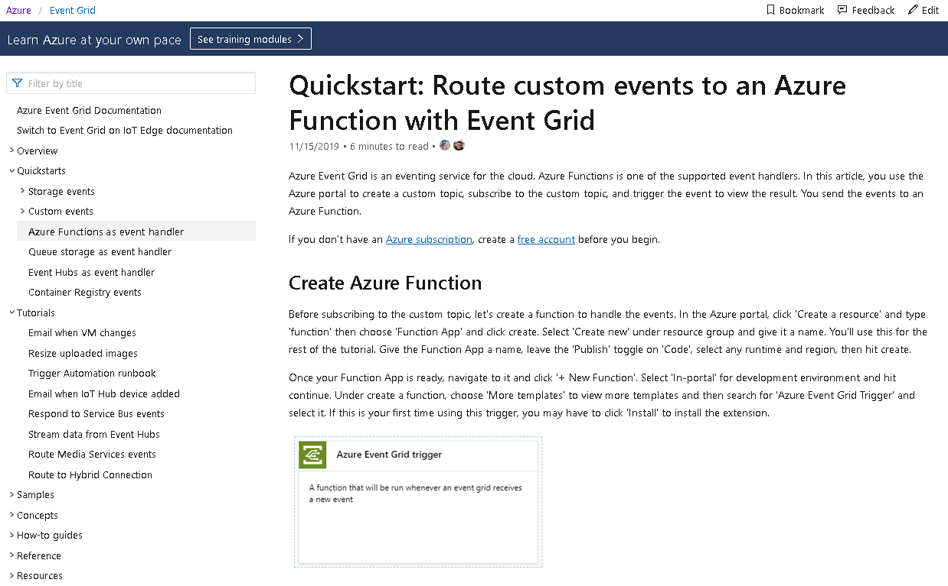
Event Grid – Getting Started
Docs - https://docs.microsoft.com/en-us/azure/event-grid/

Slide 26
Event Grid – Comments?
LinkedIn
https://www.linkedin.com/in/jeff-chilberto-2a89a84/
Twitter
https://twitter.com/JChilberto
Microsoft Tech Community
https://techcommunity.microsoft.com/t5/azure-developer-community-blog/bg-p/AzureDevCommunityBlog

